Slide 1
UML
Instructor - Andrew O’Fallon
Cpt S 122 (7/22/13)
Washington State University
Notes:
C. Hundhausen, A. O’Fallon

Slide 2
UML as a Model
UML is a notational syntax for expressing Object Oriented models
Merges Booch, Rumbaugh, and Jacobson
Not a methodology (although the Unified Process is)
UML Models can (should be) an important source for test
A. O’Fallon, J. Hagemeister
Notes:
C. Hundhausen, A. O’Fallon

Slide 3
Relationships in UML Models
Relationships in models can show a dependency between two instances
The example shows a relationship such that a student takes 0 to many classes; We might question the many (limiting it to some max value) but we can definitely look for tests about this relationship
Class
Student
takes
0..*
Built in relationships have a corresponding generic test requirements that can be identified by applying a relational test strategy to each UML diagram
A. O’Fallon, J. Hagemeister
Notes:
C. Hundhausen, A. O’Fallon

Slide 4
General Purpose Elements of UML
Organize diagrams
Express details
A. O’Fallon, J. Hagemeister
Notes:
C. Hundhausen, A. O’Fallon

Slide 5
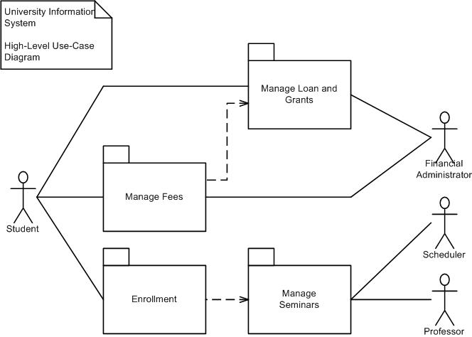
Packages and Package Diagrams
Package
  A group of UML diagrams and diagram elements of any kind, including other packages
A package diagram shows the organization of packages
A. O’Fallon, J. Hagemeister
Notes:
C. Hundhausen, A. O’Fallon

Slide 6
Expressions, Constraints, Comments, and NOTES
Expression ➔ a string from an executable language that can be evaluated to produce a result
Constraints ➔ a predicate expression on an element
Comments ➔ a natural language constraint
A note is a box with a dog eared corner. It may or may not be connected to a diagram element. It contains a textual description or explanation.
A. O’Fallon, J. Hagemeister
Notes:
C. Hundhausen, A. O’Fallon

Slide 7
Use Case Models (1)
Query weather&snow forecast
<<include>>
Book room
Enter personal info
Visitor
Book SB course
<<include>>
<<extend>>
(Enter kid’s age)
Cancel course
Book kids’ SB course
Cancel room
A. O’Fallon, J. Hagemeister
Notes:
C. Hundhausen, A. O’Fallon

Slide 8
Use Case Models (2)
Use Case: Book SB course
Precond: -
Main flow:
      Visitor enters date
      Include (Enter personal info)
      (Enter kid’s age)
      Store reservation
      Confirm reservation to Visitor
Exceptional flow:
  If number of course participants for specified date > 8, then tell visitor so and let him choose another date
A. O’Fallon, J. Hagemeister
Notes:
C. Hundhausen, A. O’Fallon

Slide 9
Use Case Models (3)
Use Case: Book kids’ SB course
Precond: SB course is for a kid
Main flow:
      Enter kid’s age
      Store reservation
      Confirm reservation to Visitor
Exceptional flow:
  If course for specified date is adult course, then tell visitor so and let him choose another date
Exceptional flow:
  If course for specified date is kids’ course, and the specified age is outside the course’s age range, then tell visitor so and let him choose another date
A. O’Fallon, J. Hagemeister
Notes:
C. Hundhausen, A. O’Fallon

Slide 10
Use Case
An abstraction of the system to model behavior to external interaction
Accomplish important tasks from the user’s point of view
Represent system requirements
  Functional
  Allocation to classes
  Object interaction and interfacing
  User interfaces
  User documentation
A. O’Fallon, J. Hagemeister
Notes:
C. Hundhausen, A. O’Fallon

Slide 11
Class Diagram
Central for OO modeling
Shows static structure of the system
  Types of objects
  Static relationships
    Association
    (e.g.: a company has many employees)
    Generalization (subtypes)
    (e.g.: an employee is a kind of person)
    Dependencies (Aggregation)
    (e.g.: a company is using trucks to ship products)
A. O’Fallon, J. Hagemeister
Notes:
C. Hundhausen, A. O’Fallon

Slide 12
Class
Set of objects
Defines
  Name
  Attributes
  (optional: type
  optional: initial value)
  Operations
Task
startDate: Date = default
endDate: Date
name
setStartDate (d : Date)
setEndDate (d : Date)
getDuration () : Date
A. O’Fallon, J. Hagemeister
Notes:
C. Hundhausen, A. O’Fallon

Slide 13
Class diagram example
Actuator
association
startUp( )
shutDown( )
generalization
Light
Heater
Cooler
Temperature
off( )
1
1
on( )
aggregation
0..*
1
1
1
Environmental Controller
SystemLog
define_climate( )
display( )
A. O’Fallon, J. Hagemeister
terminate_climate( )
recordEvent( )
Notes:
C. Hundhausen, A. O’Fallon

Slide 14
Sequence Diagrams
Shows object interactions arranged in time sequence
It focuses on
  Objects (and classes)
  Message exchange to carry out the scenarios functionality
The objects are organized in an horizontal line and the events in a vertical time line
A. O’Fallon, J. Hagemeister
Notes:
C. Hundhausen, A. O’Fallon

Slide 15
Notation Example (simple version)
Messages point from client to supplier
: Professor
CourseManager
Math 101 - Section
1 : CourseOffering
Add professor (Professor)
Lifeline
Message
A. O’Fallon, J. Hagemeister
Notes:
C. Hundhausen, A. O’Fallon

Slide 16
Sequence Diagram: Larger Example
course form :
CourseForm
theManager :
CurriculumManager
: Registrar
Object
creation
1 : set course info
2 : process
3 : add course
aCourse :
Course
4 : <<create>>
A. O’Fallon, J. Hagemeister
Notes:
C. Hundhausen, A. O’Fallon

Slide 17
Sequence Diagrams: More Details
an Order
an Order
an Order
a Stock Item
Self
delegation
Entry window
Line
1: prepare()
2: * prepare()
3: check()
4: [check = true]
remove()
5: needsToReorder()
Iteration
Condition
6: [needsToReorder = true]
<<create>>
a Reorder
Item
Asynchronous
Message
Activation
Return arrow
A. O’Fallon, J. Hagemeister
Notes:
C. Hundhausen, A. O’Fallon

Slide 18
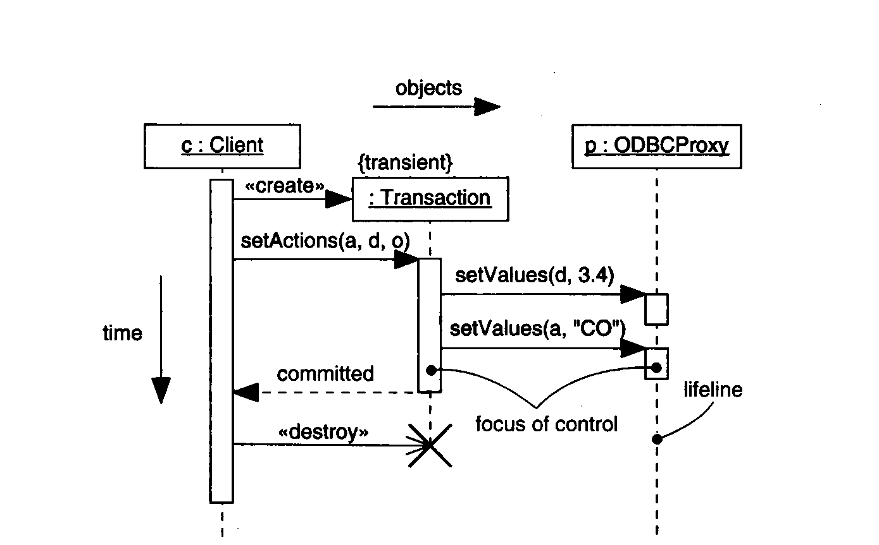
Example of a Transaction
From: G. Booch, J.Rumbaugh, I. Jacobson: The Unified Modeling Language User Guide.
Addison Wesley, 1999, fig 18-2 page 247
A. O’Fallon, J. Hagemeister
Notes:
C. Hundhausen, A. O’Fallon
In this examples all the new features of UML 1.3 are shown with reference to interaction diagram...

Slide 19
Content of Sequence Diagrams
Objects
  They exchange messages among each other
Messages
  Synchronous: “call events,” denoted by the full arrow; Duration of synchronization should be indicated by activation bar or return arrow
  Asynchronous: “signals,” denoted by a half arrow
  There are also «create» and «destroy» messages
A. O’Fallon, J. Hagemeister
Notes:
C. Hundhausen, A. O’Fallon

Slide 20
Asynchronous messages
Do not block the caller
Can do 3 things:
  Create a new thread
  Create a new object
  Communicate with a thread that is already running
A. O’Fallon, J. Hagemeister
Notes:
C. Hundhausen, A. O’Fallon

Slide 21
References
Robert V. Binder, Testing Object-Oriented Systems: Models, Patterns, and Tools, Addison-Wesley, 2000.
Edward Kit, Software Testing in the Real World: Improving the Process, Addison-Wesley, 1995
A. O’Fallon, J. Hagemeister
Notes:
C. Hundhausen, A. O’Fallon

Slide 22
Collaborators
Jack Hagemeister
A. O’Fallon, J. Hagemeister
Notes:
C. Hundhausen, A. O’Fallon

